Slide 1
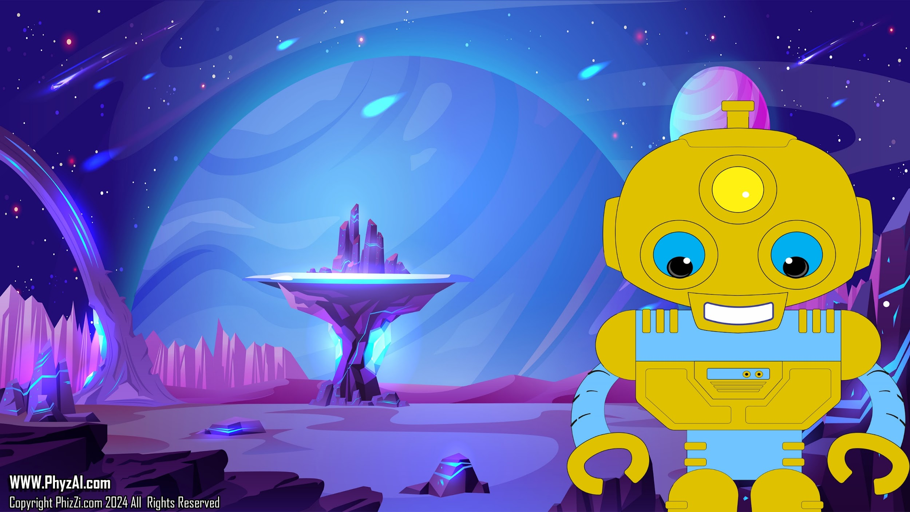
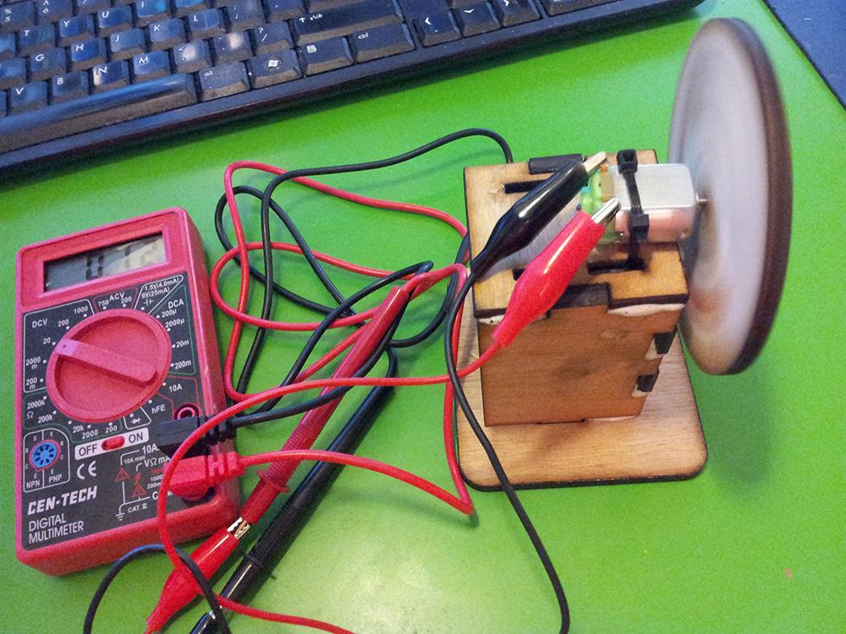
Lets Make a Generator
Notes:
Welcome, future scientists and engineers! Today, we're embarking on a galactic adventure to create our very own electrical generator, right here on Earth, using some simple materials and a sprinkle of cosmic ingenuity. So, buckle up and get ready for a ride through the wonders of electricity and innovation! After a little space turbulence, my ship and the Blarts need to recharge our batteries. Luckily, building an electrical generator is easier than dodging asteroids, and with your brilliant minds, it will indeed be a walk in space!

Slide 2
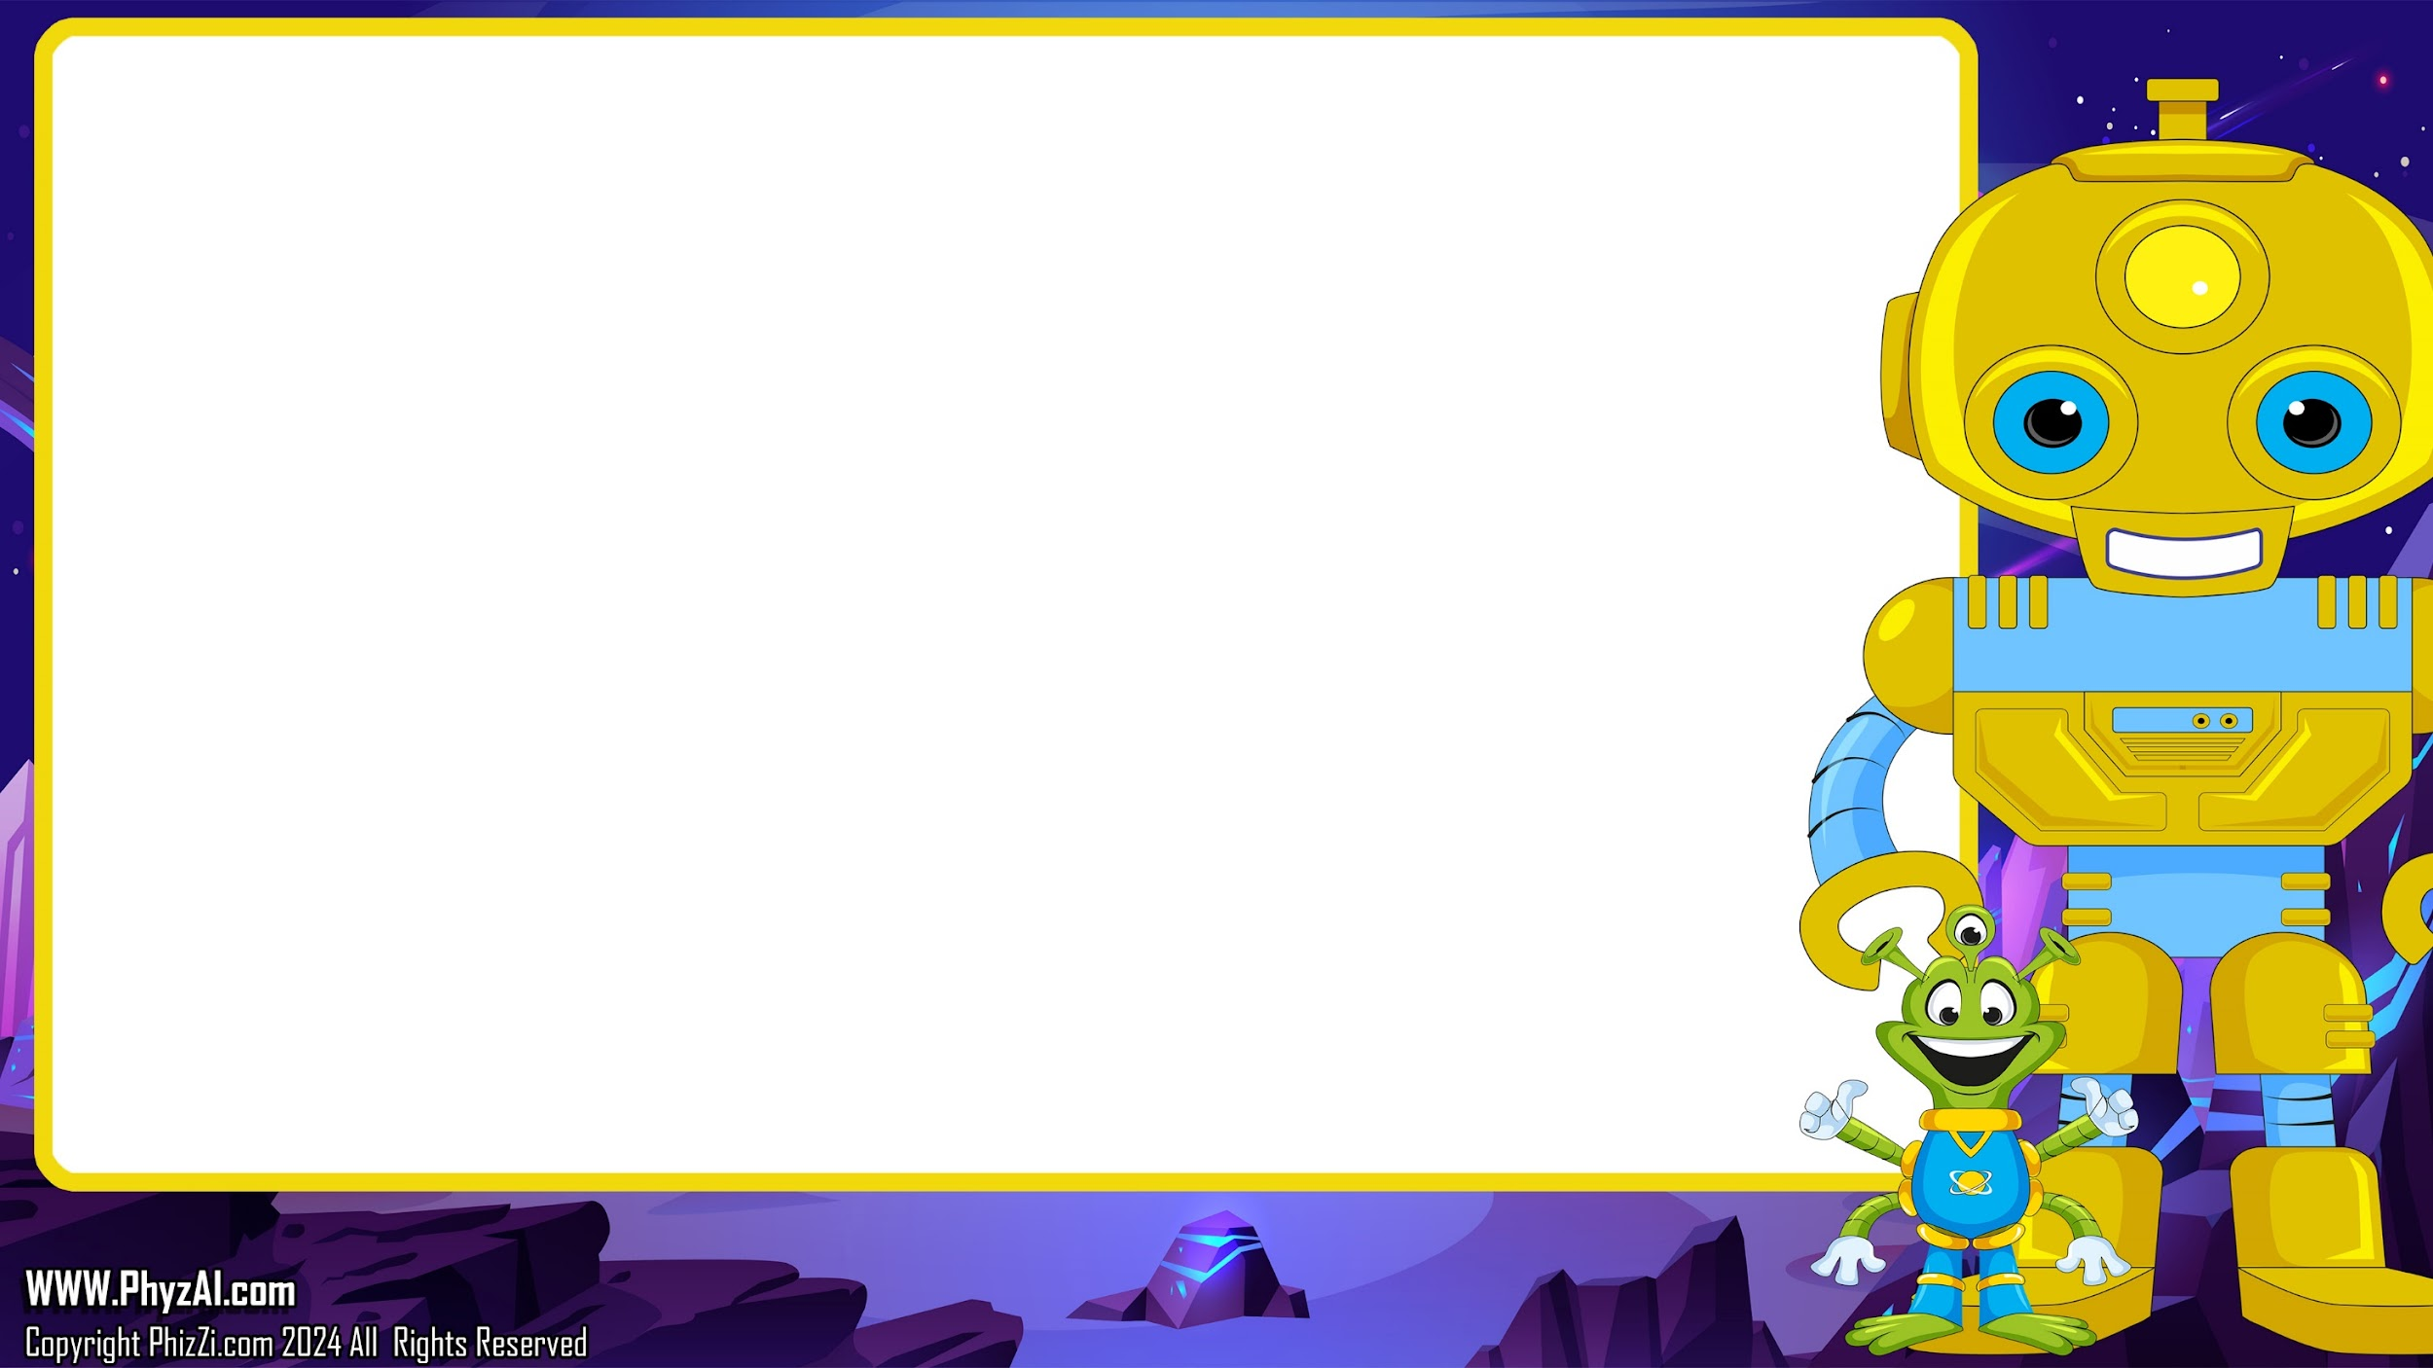
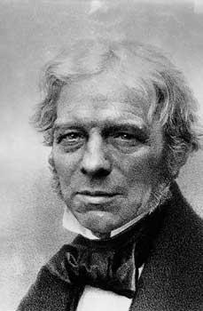
In 1831, a really smart guy named Michael Faraday (who was a maker way before being a maker was cool so he just called himself a scientist) discovered that if magnets move inside a coil of wire, electrical current will flow.
-
+
Notes:
Back in 1831, Michael Faraday, a scientist who could have been a spaceman if he had the chance, discovered something amazing: moving magnets inside a coil of wire generates electrical current. This discovery powers not just planets but possibly other galaxies too!

Slide 3

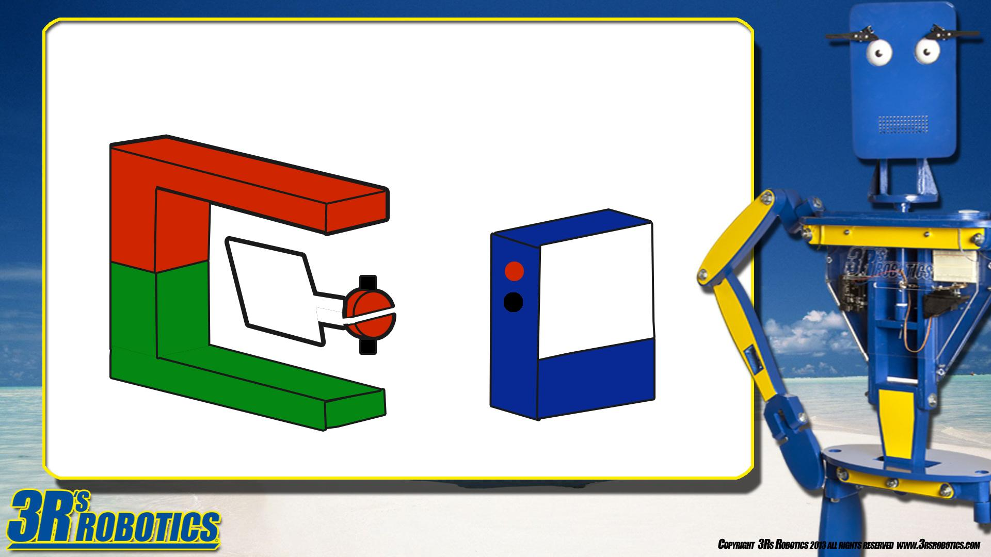


To make a generator, we need to spin a coil of wire next to two or more magnets and atoms start moving.
P
N
Notes:
To make our generator, we need a few key components:
Two magnets, a coil of wire, and a commutator (to keep connections as the coil spins)

Slide 4
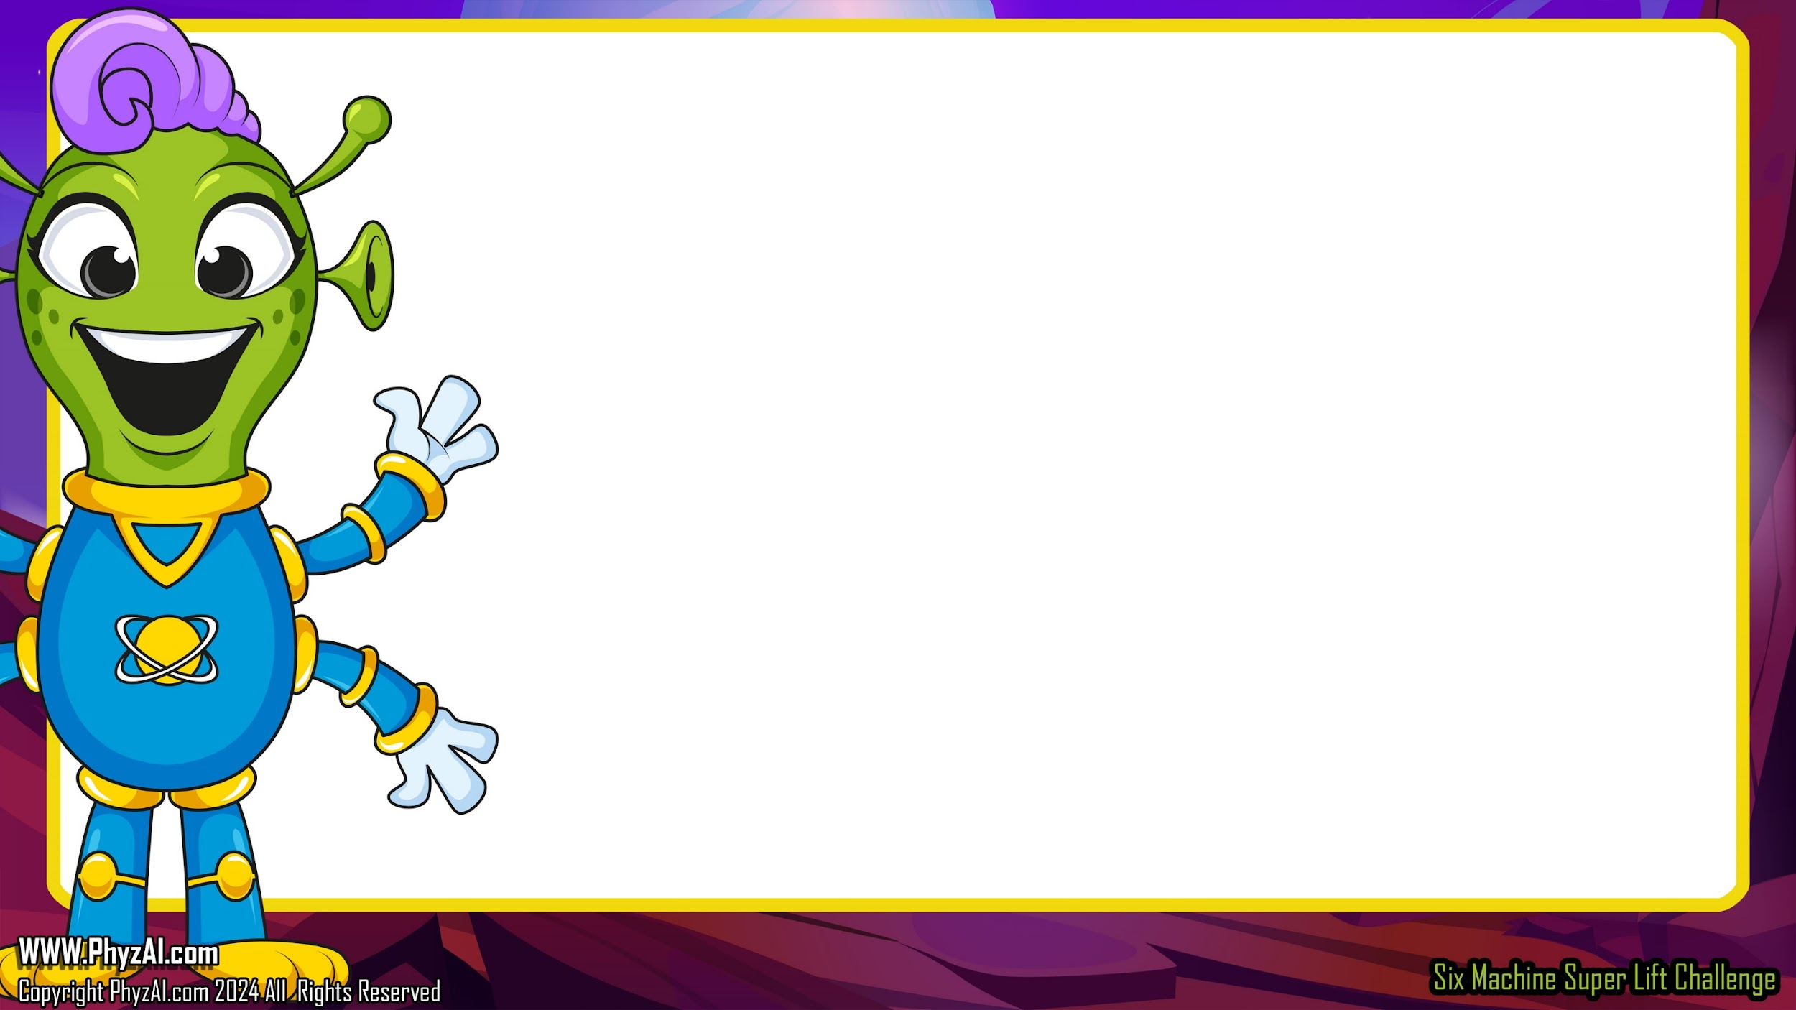
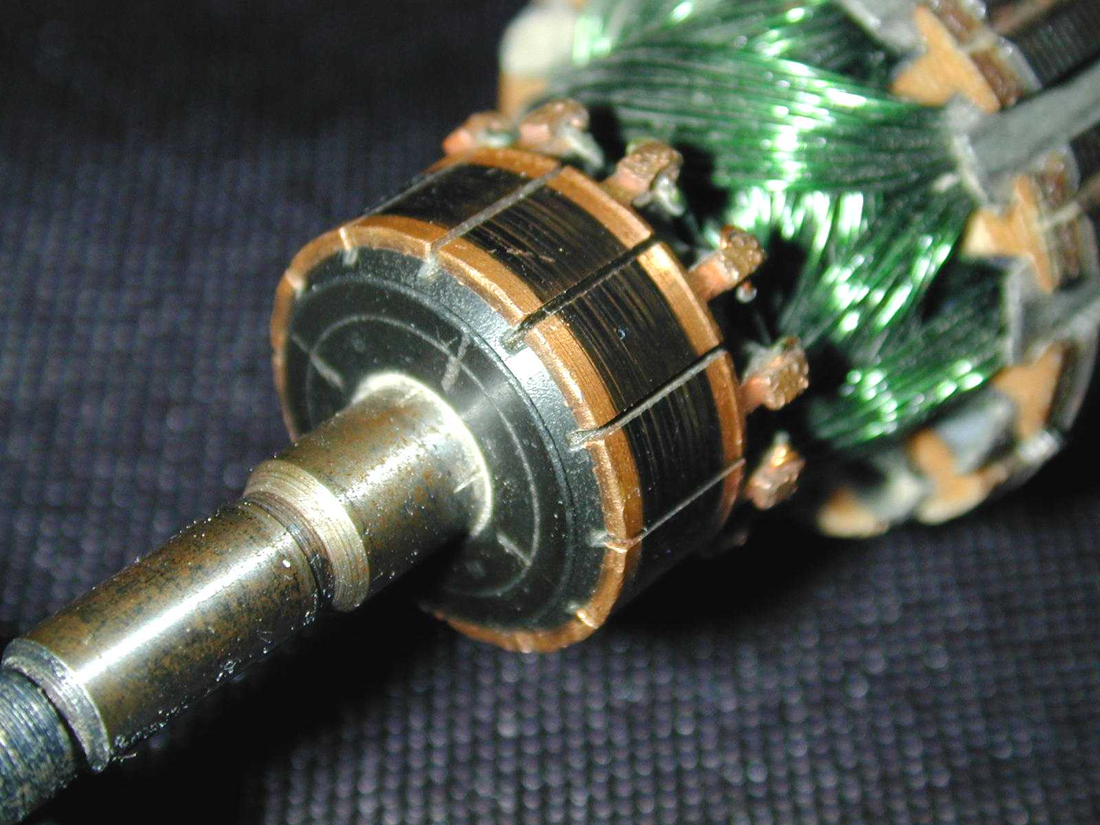
A commutator makes sure the wires stay in contact with the coil as the coil spins.
The commutator is split so only one wire from the coil ever touches one coil at one time.
This is a commutator from A modern
generator. Note it has many sides,
unlike our simple diagram
Notes:
A commutator ensures that the wires consistently touch the coil even as it spins. This clever device is designed with a split, allowing just one wire from the coil to connect with one segment of the coil at any given time.

Slide 5
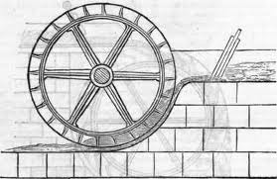
The real key to generating electrical power is to understand that in order to generate electrical power, we must start with a chemical or mechanical process.
All power must be mined, harnessed
or collected.
Notes:
The real key to generating electrical power is to understand that in order to generate electrical power, we must start with a chemical or mechanical process.
All power must be mined, harnessed or collected.

Slide 6
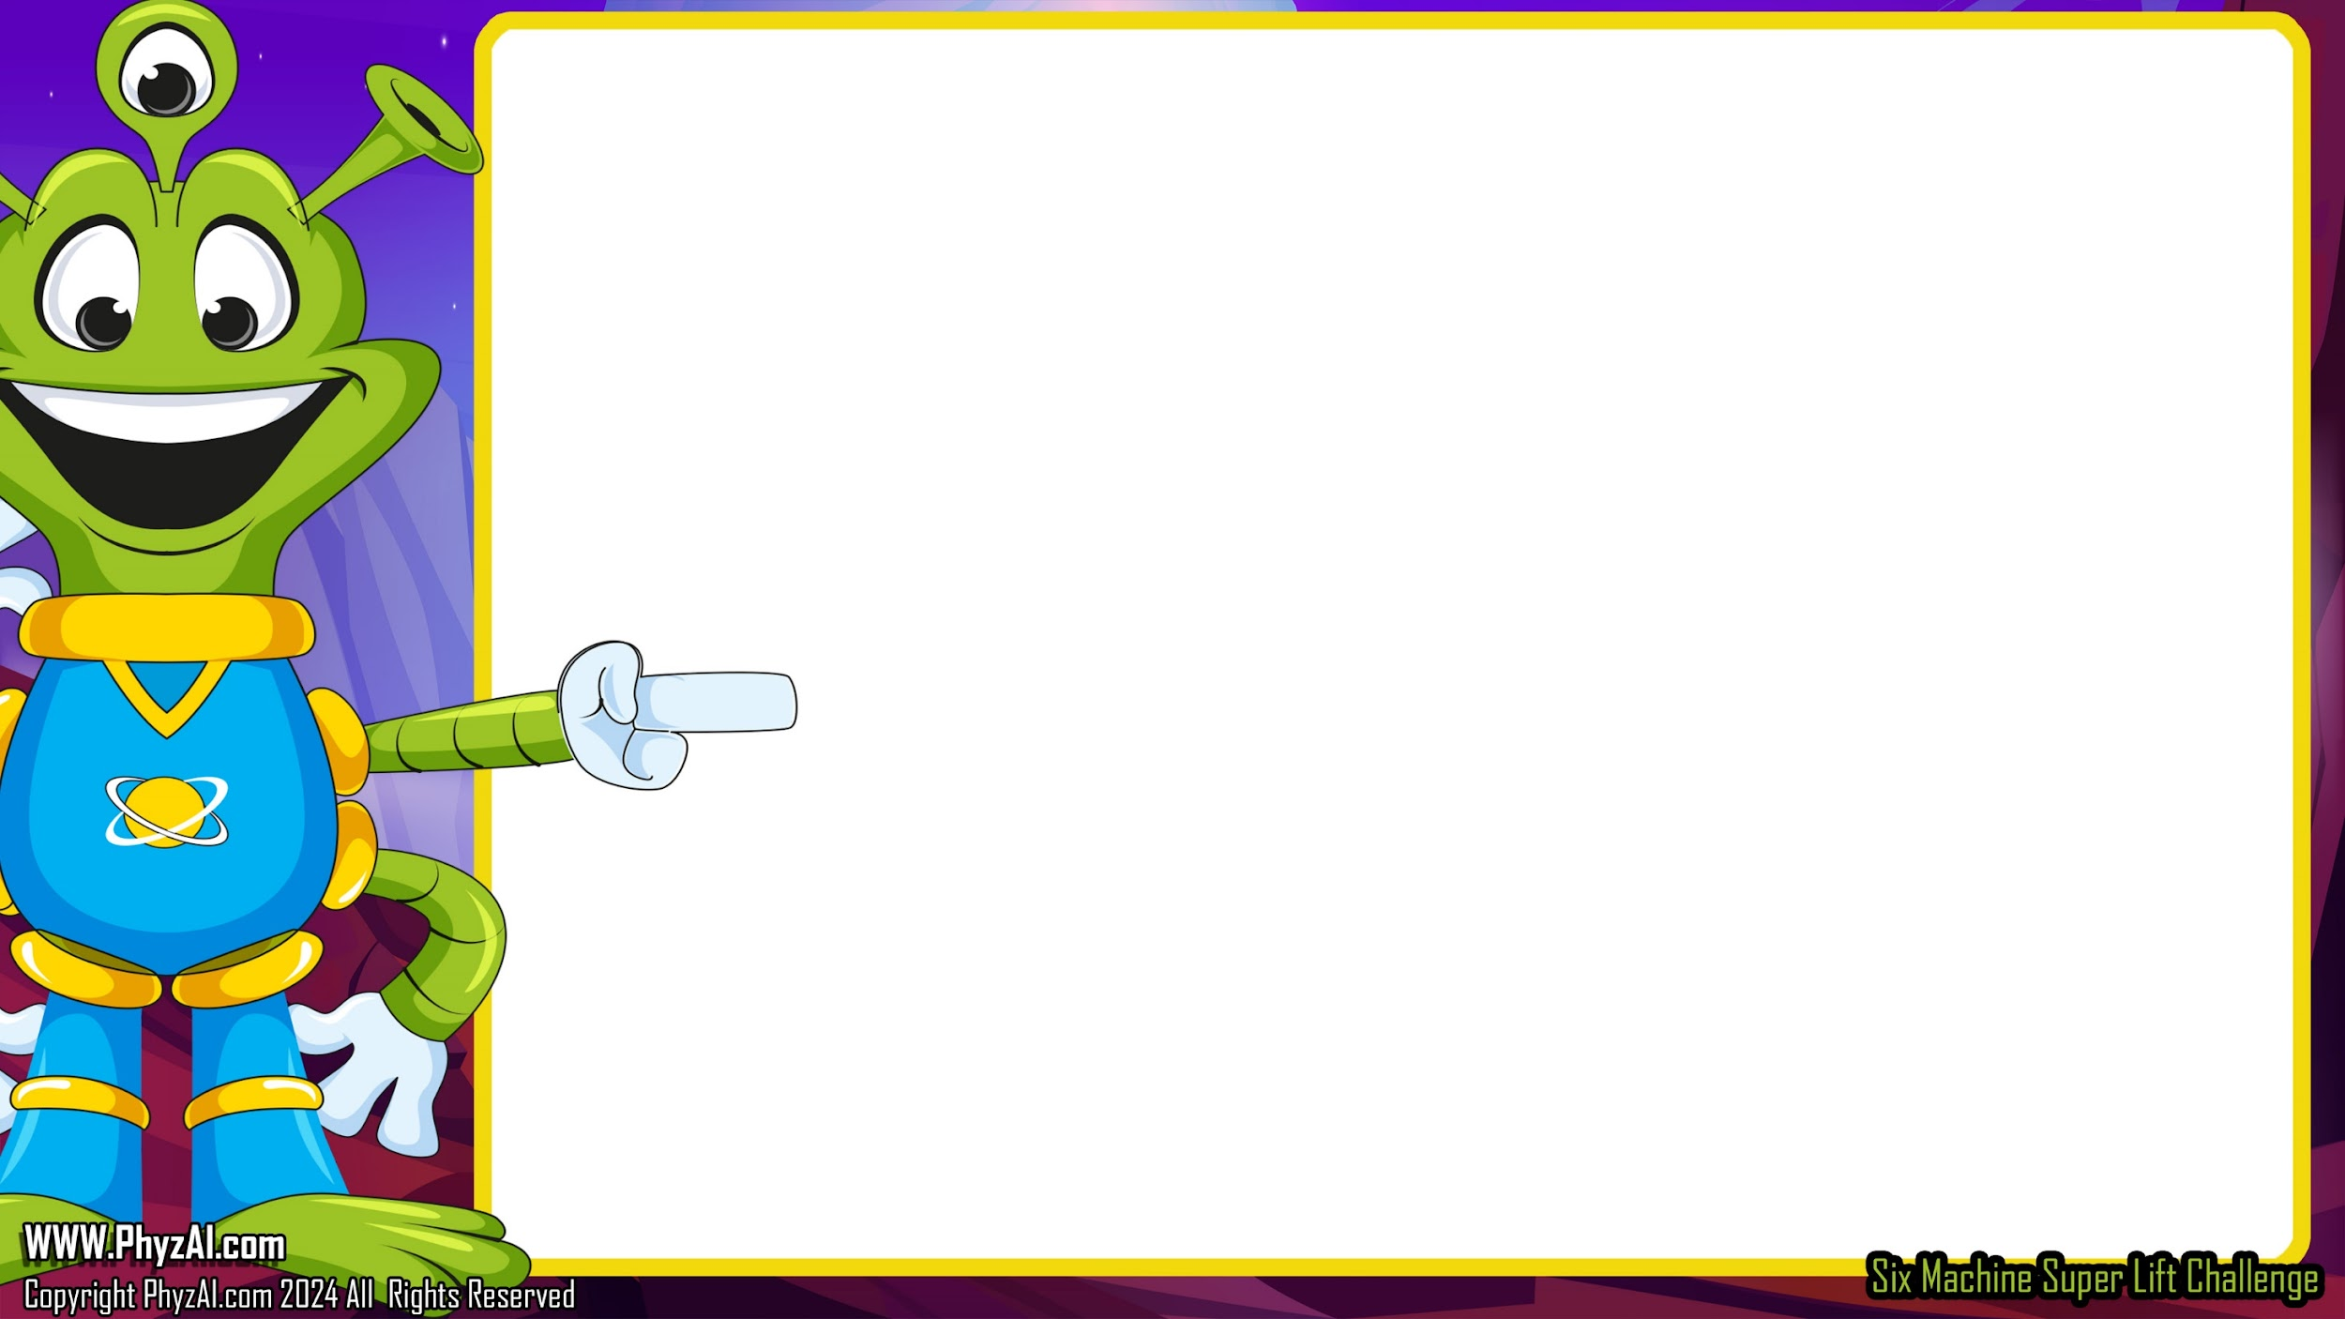
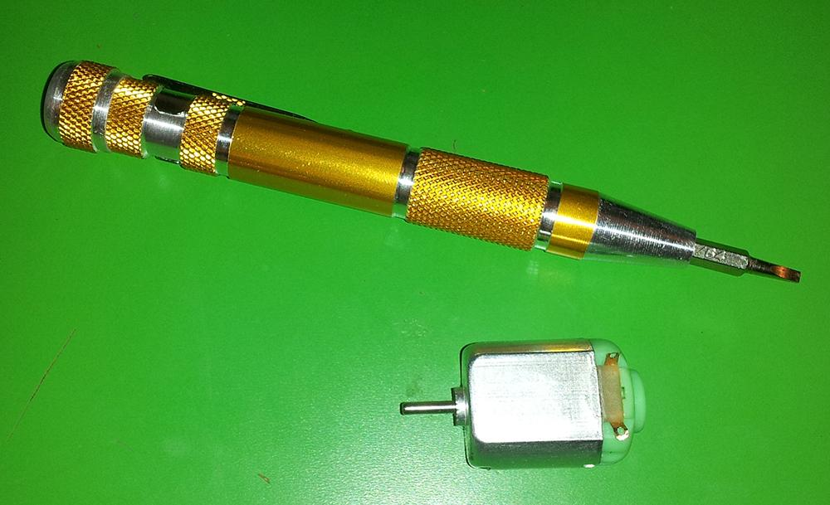
Let's
make a generator!
We'll be making a generator from a DC hobby motor.
Notes:
We're harnessing the power of a humble DC hobby motor to construct our generator. Nestled within this motor are the essential **magnets** and **coils** – the dynamic duo we need to start generating electricity.

Slide 7
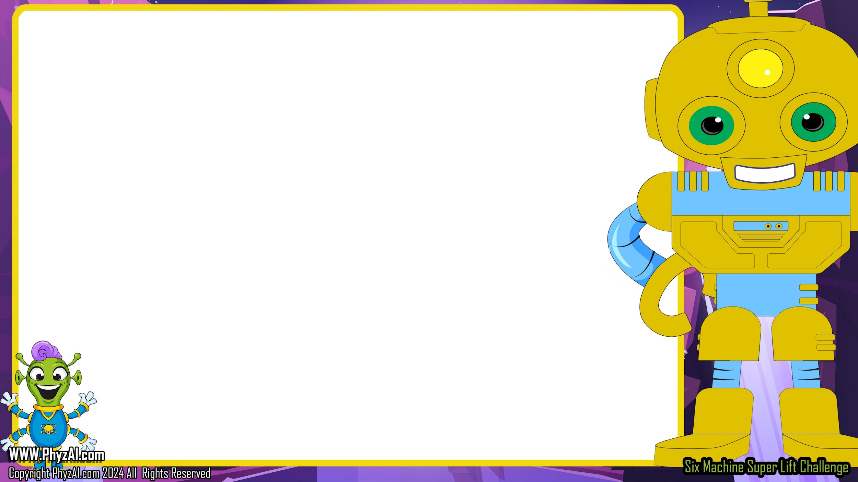
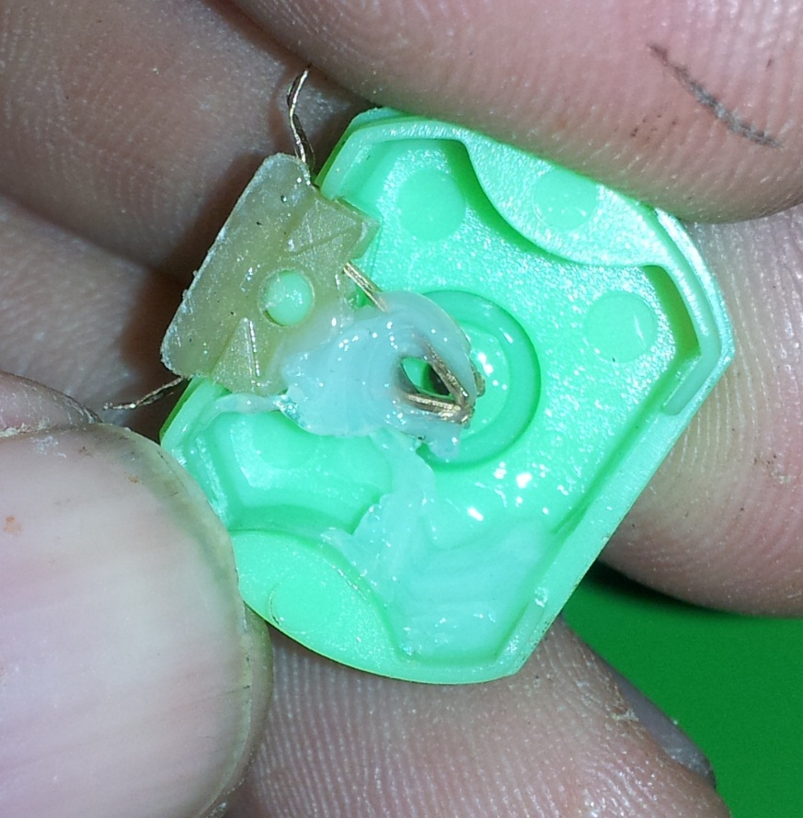
First, let's take a look at what's inside...
We start by removing the colored back of the motor.
The wires
inside will act
as the brushes for the generator's commutator.
Notes:
Let's start our engineering journey by dismantling the motor. Remove the colorful back to expose the internal wires and commutator. The wires inside will act as the brushes for the generator's commutator.

Slide 8

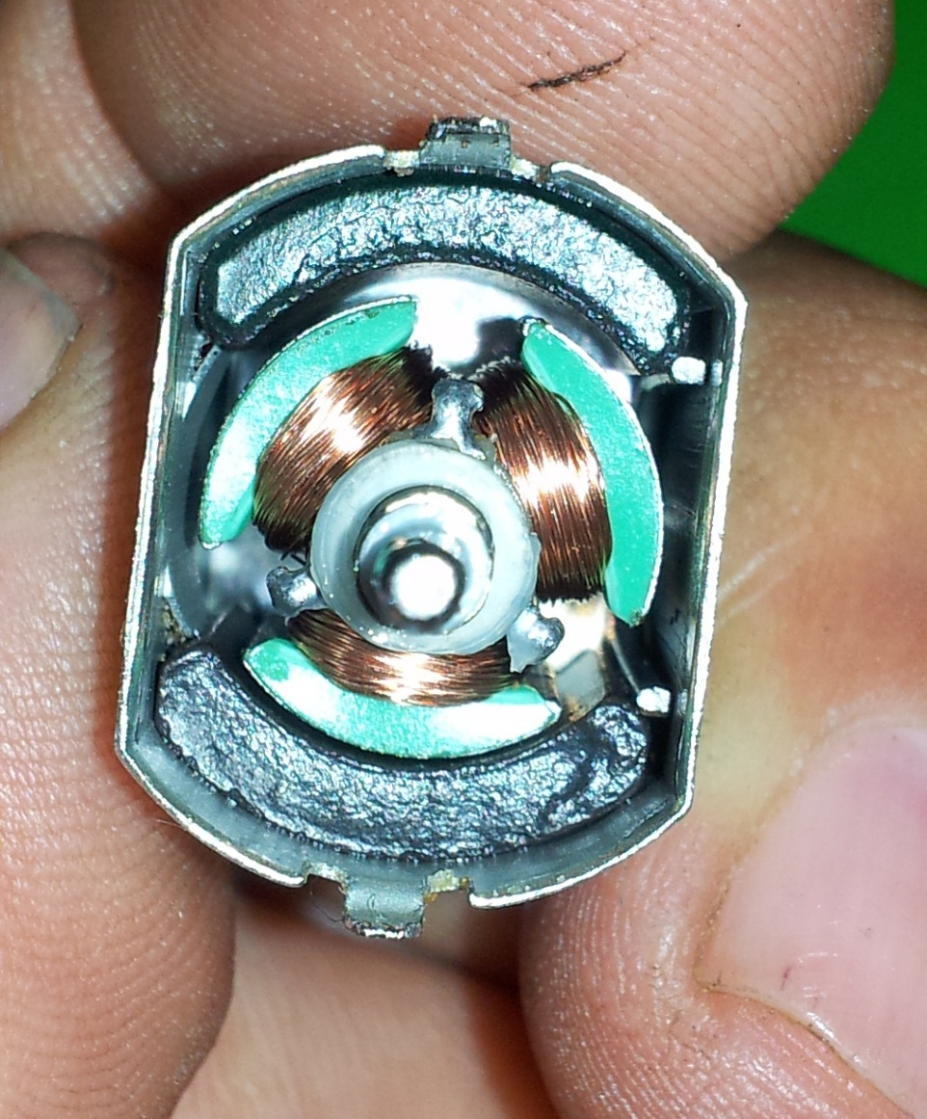
Inside,
attached to
a shaft, is everything we need to generate electricity, starting
with those
ever-important wire coils.
Notes:
Inside, attached to a shaft, is everything we need to generate electricity, starting with those ever-important wire coils.

Slide 9
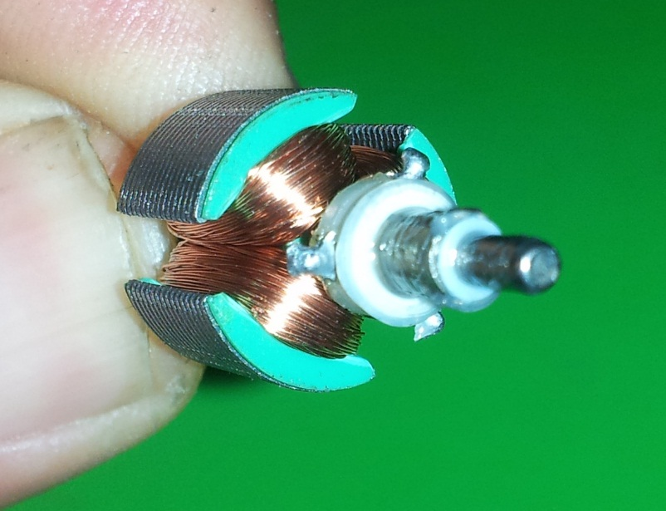

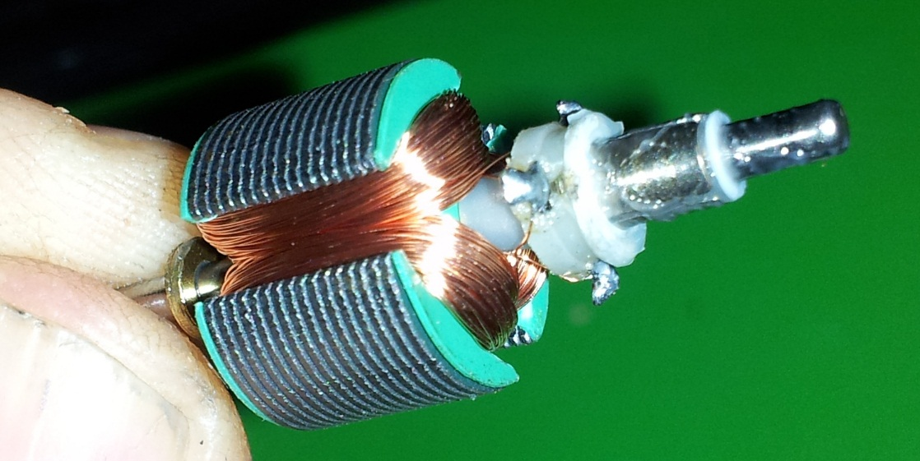
By removing the shaft, we get a better look at the wire coil.
And
there is our commutator.
Notes:
By taking out the shaft, you'll see the wire coils and the commutator up close.

Slide 10

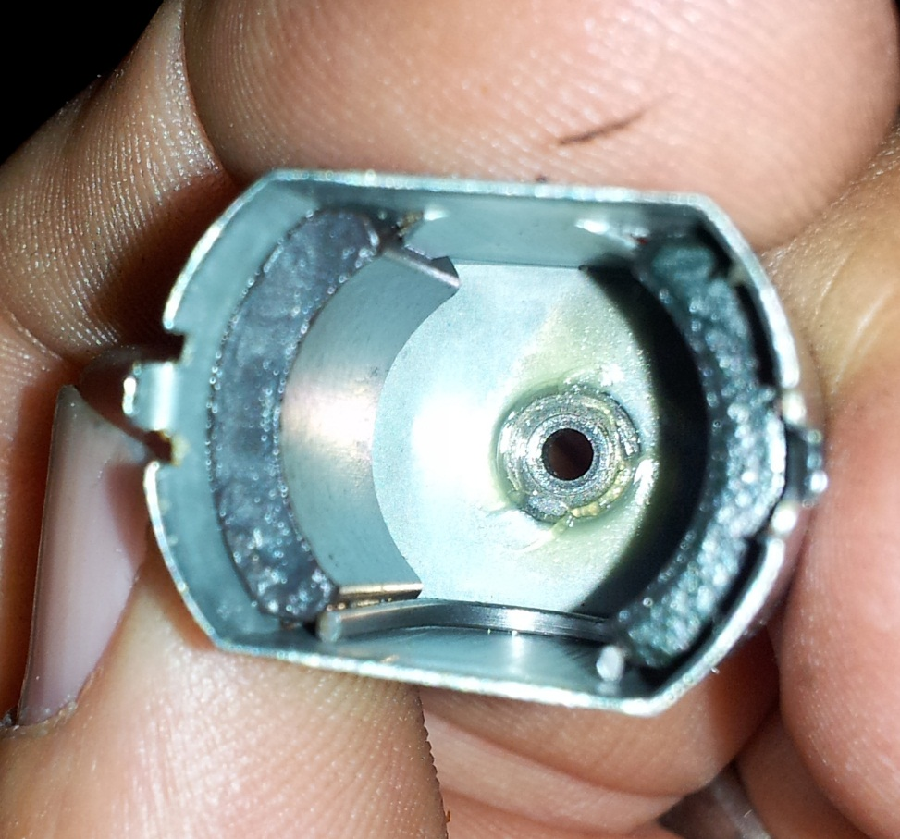
Inside the casing
are
the generator's magnets.
Notes:
Inside the casing, you'll find the magnets that are crucial for our generator

Slide 11
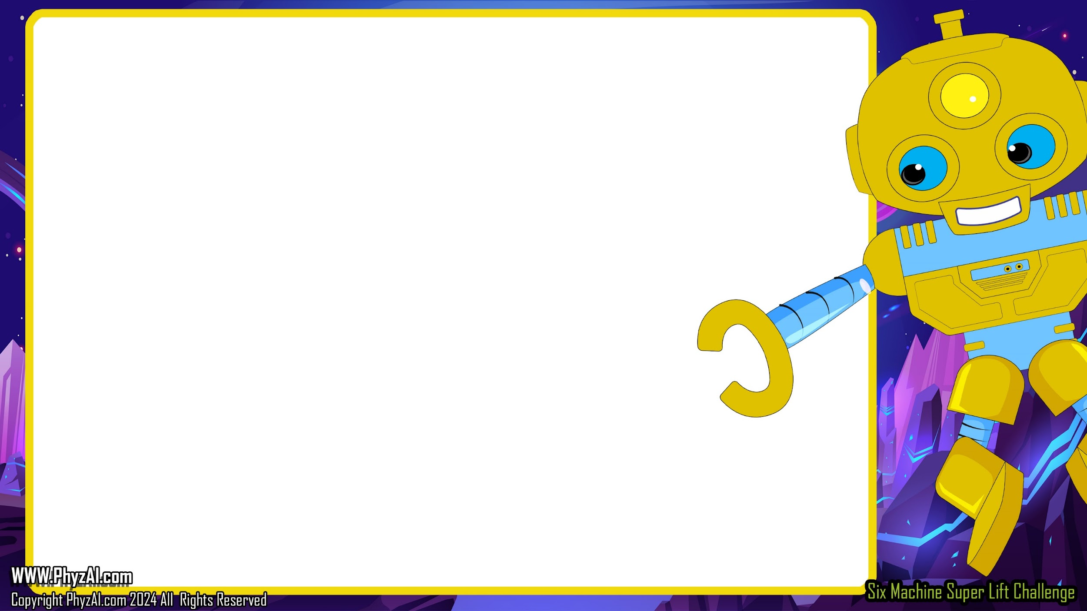
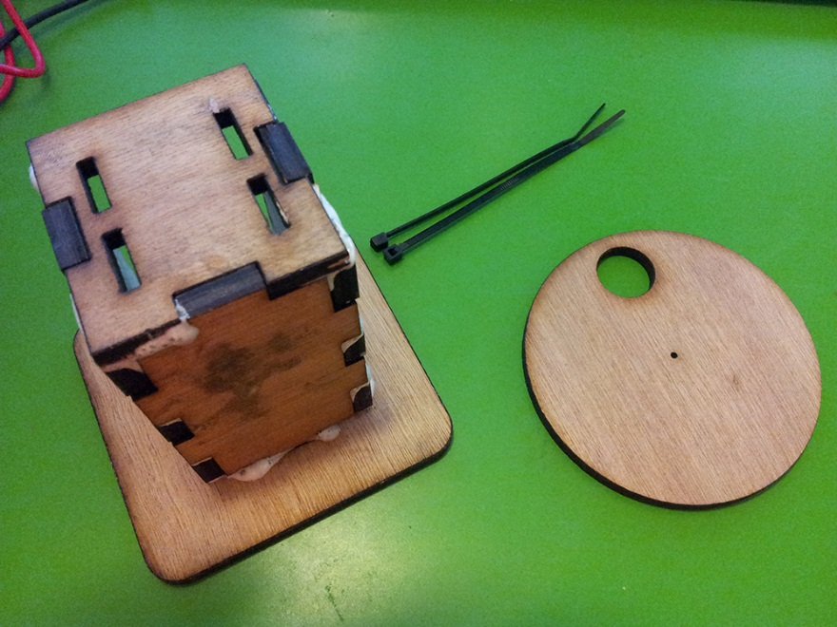
What
You'll Need to Make a Generator
1 DC Motor
2 Zip ties
Multimeter with jumper cables
Wooden motor assembly and wheel
Notes:
Gather these items:
1 DC Motor,,, 2 Zip ties,,, a Multimeter with jumper cables,,, and a Motor assembly and wheel.

Slide 12
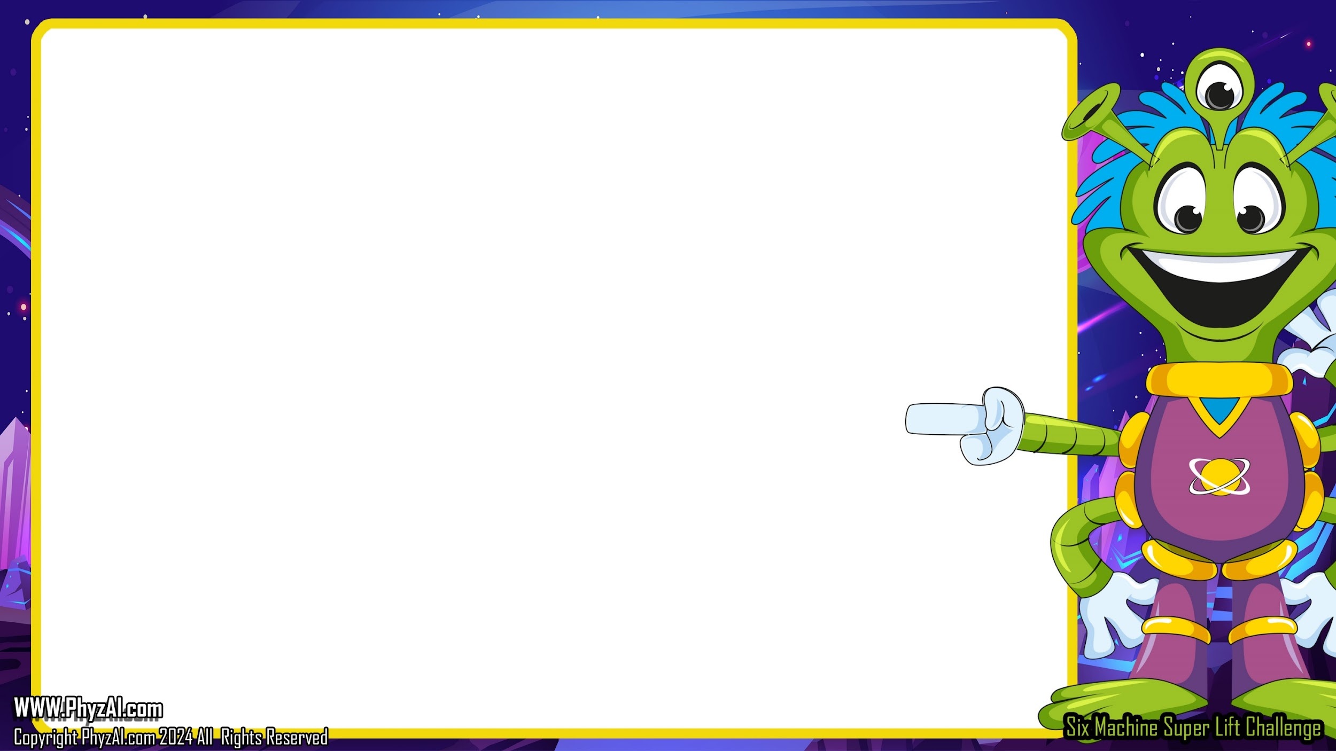
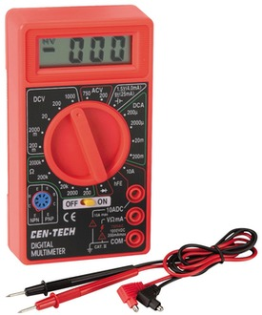
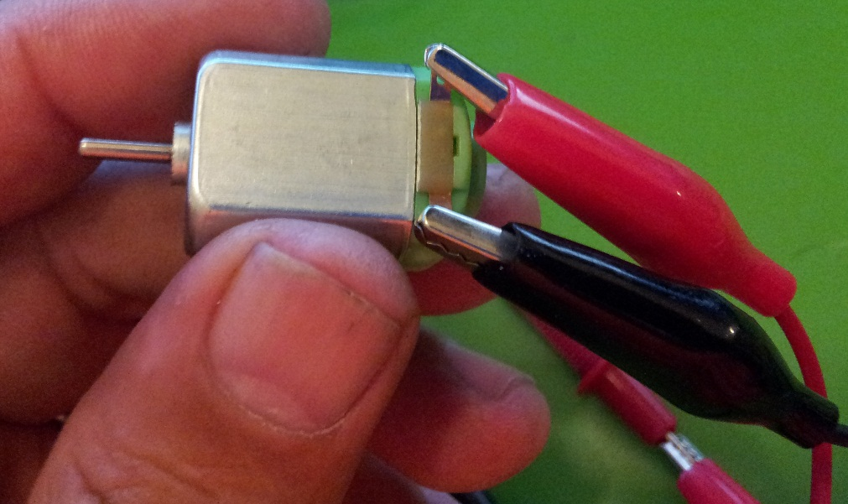
To test the generator's output, we'll use a multimeter. Plug in the negative and positive wires and connect jumper wires to both.
Then attach the jumper clamps to the leads on the side of the motor.
Notes:
To check how well our generator is doing, we're going to use a handy tool called a multimeter. First up, connect the black and red wires. Then, grab some jumper wires and hook them up too. Finally, clip the jumper clamps onto the leads on the side of the motor. Let's see what kind of power we're dealing with!

Slide 13

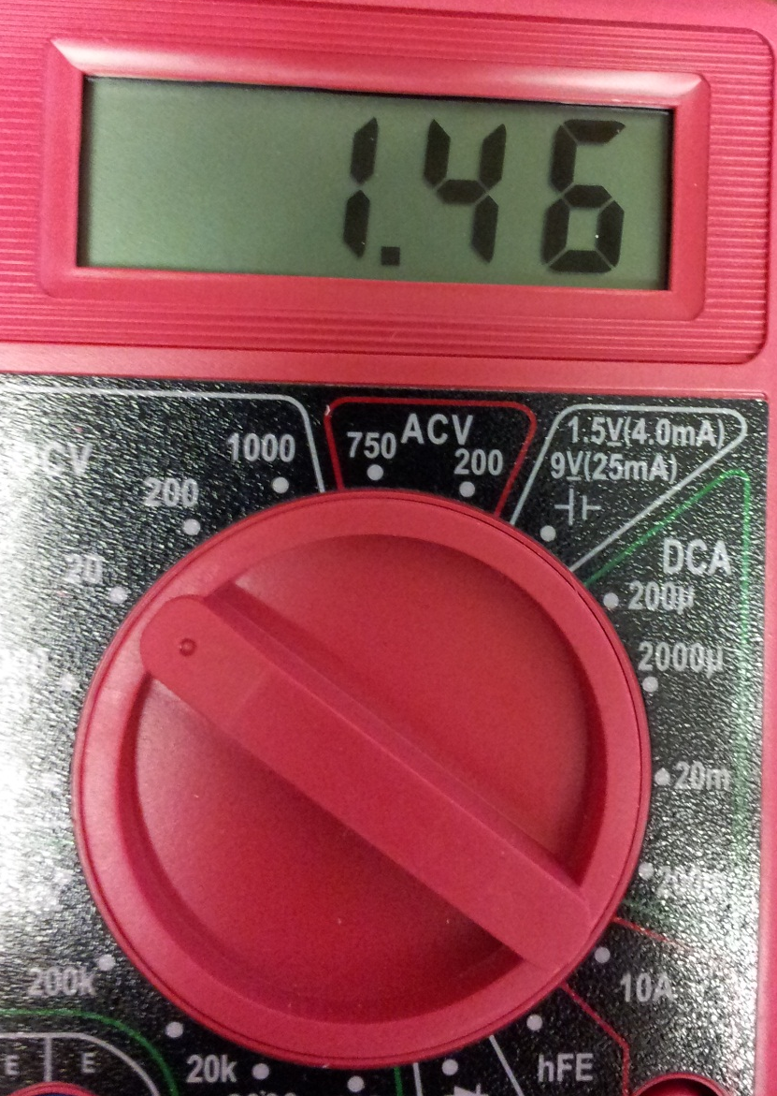


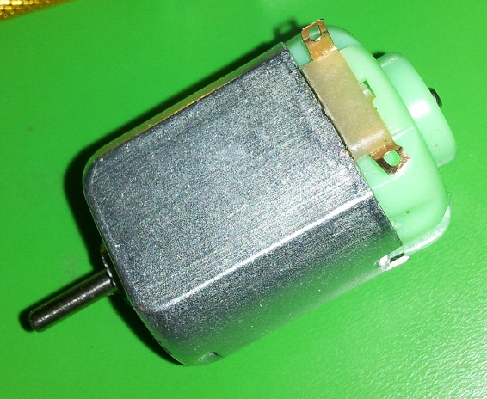
Set your multimeter
to DC 20 volts and turn it on.
Notes:
Alrighty, let's turn our multimeter into a voltage voyager! Twist that dial to DC 20 volts and flip the switch to bring it to life. It's time to see some electric excitement!

Slide 14
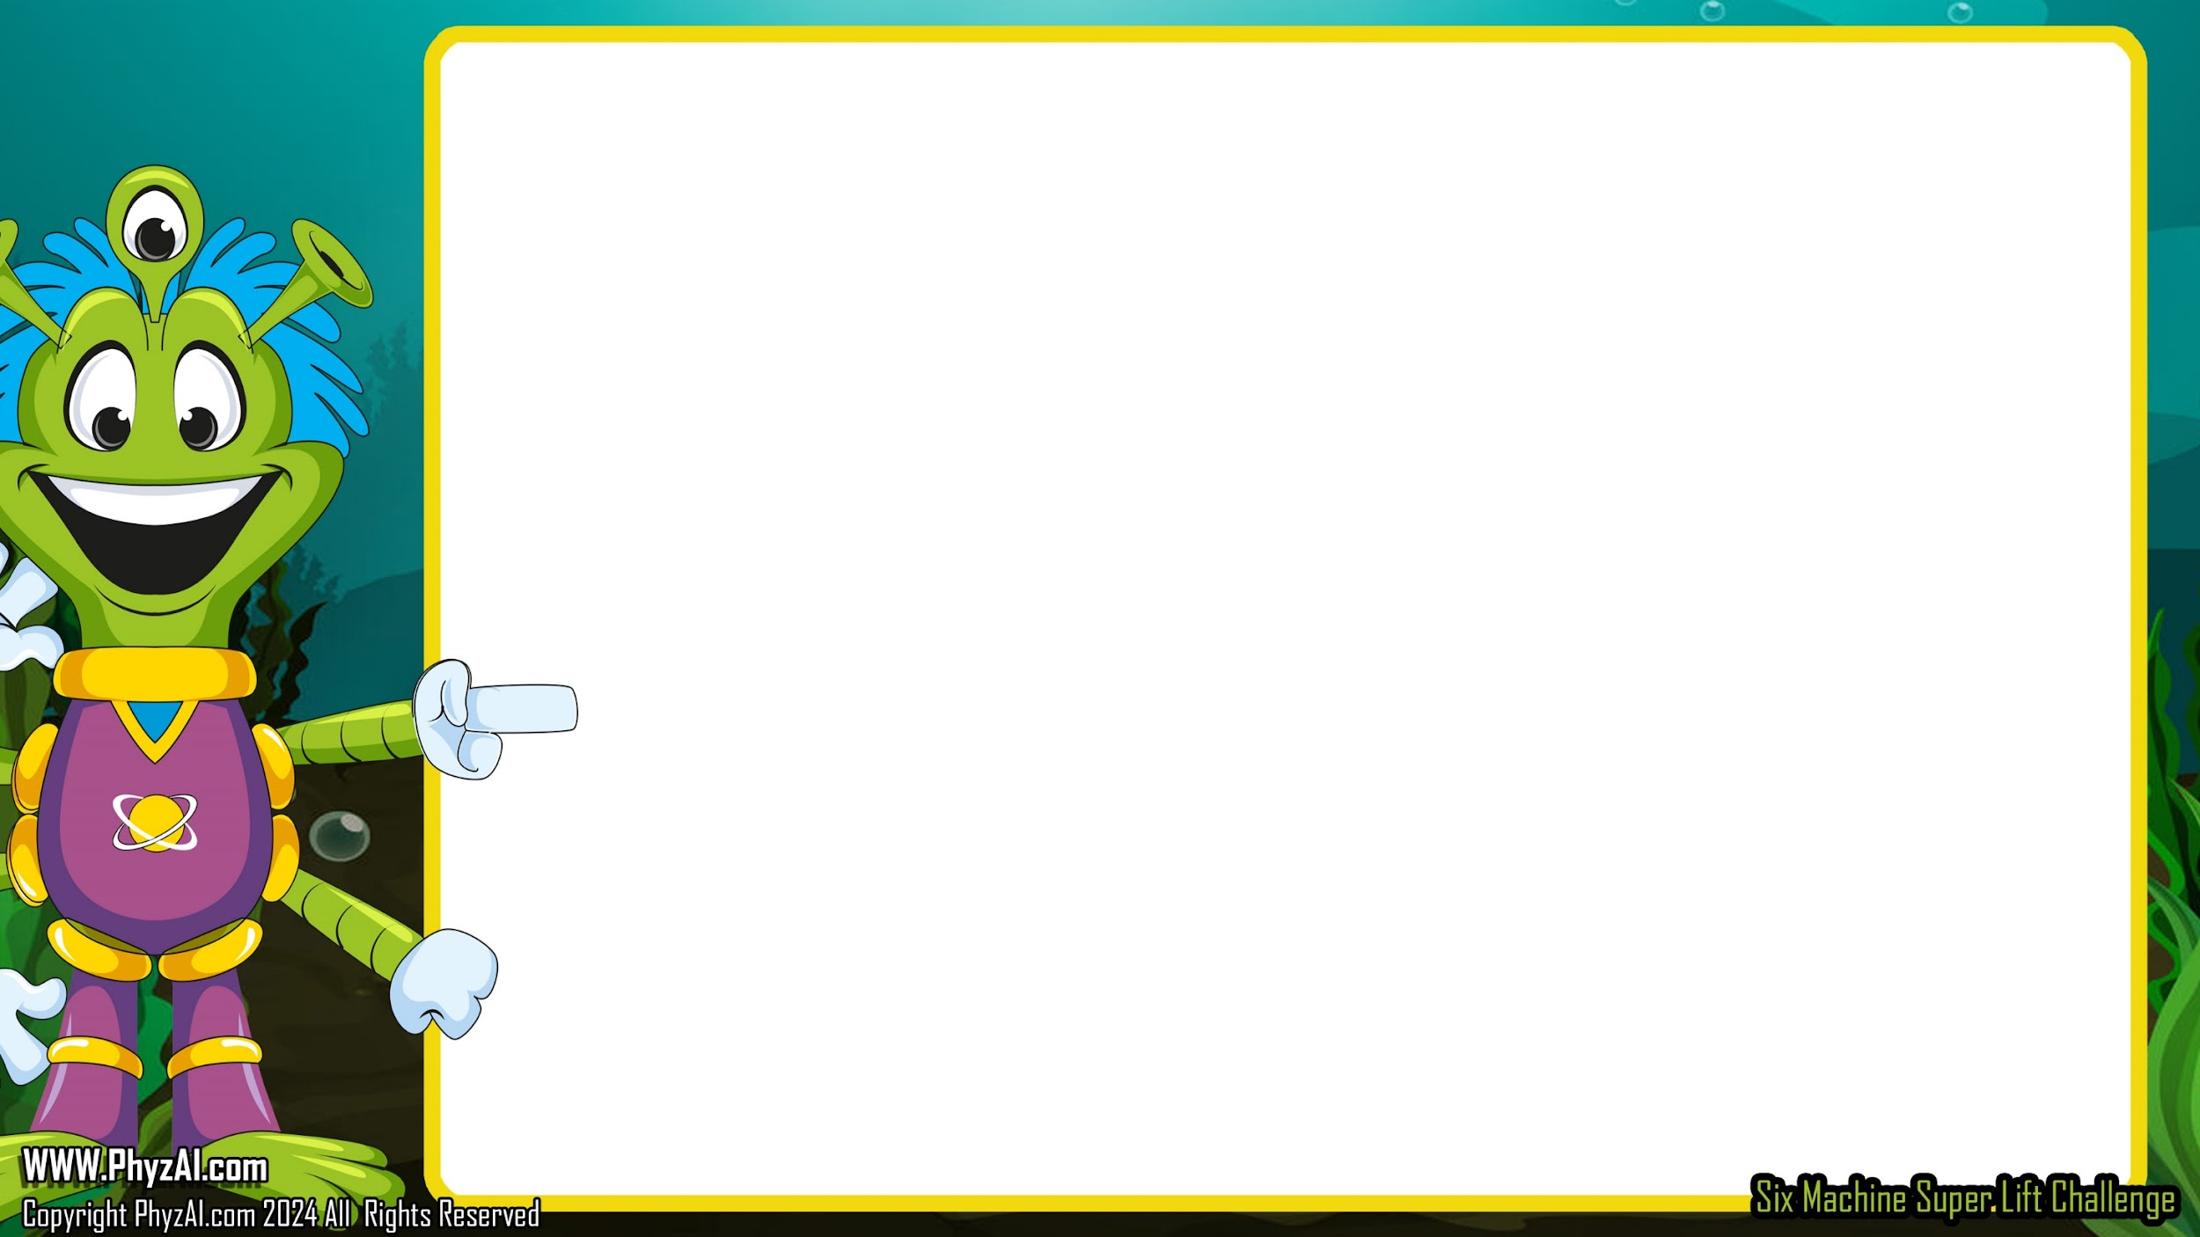
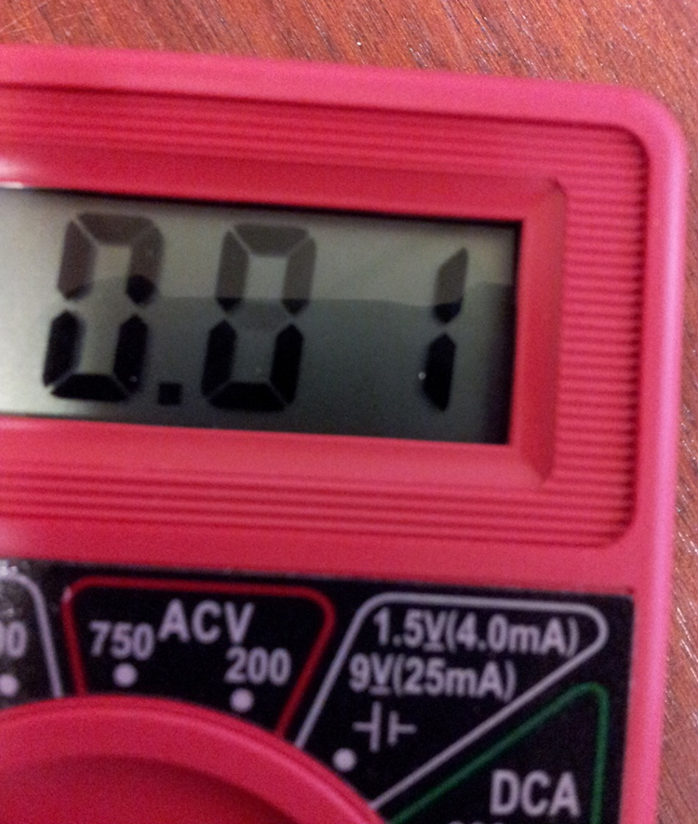
Now, by spinning
the shaft of the motor
with your fingers, the multimeter reads the output voltage of the generator.
But we can do
better than that.
Notes:
Alright, now give the motor's shaft a spin with your fingers, and watch as the multimeter tells us the generator's secret – its output voltage! But hold on to your helmets, because we're just getting started – we're going to kick it up a notch!

Slide 15

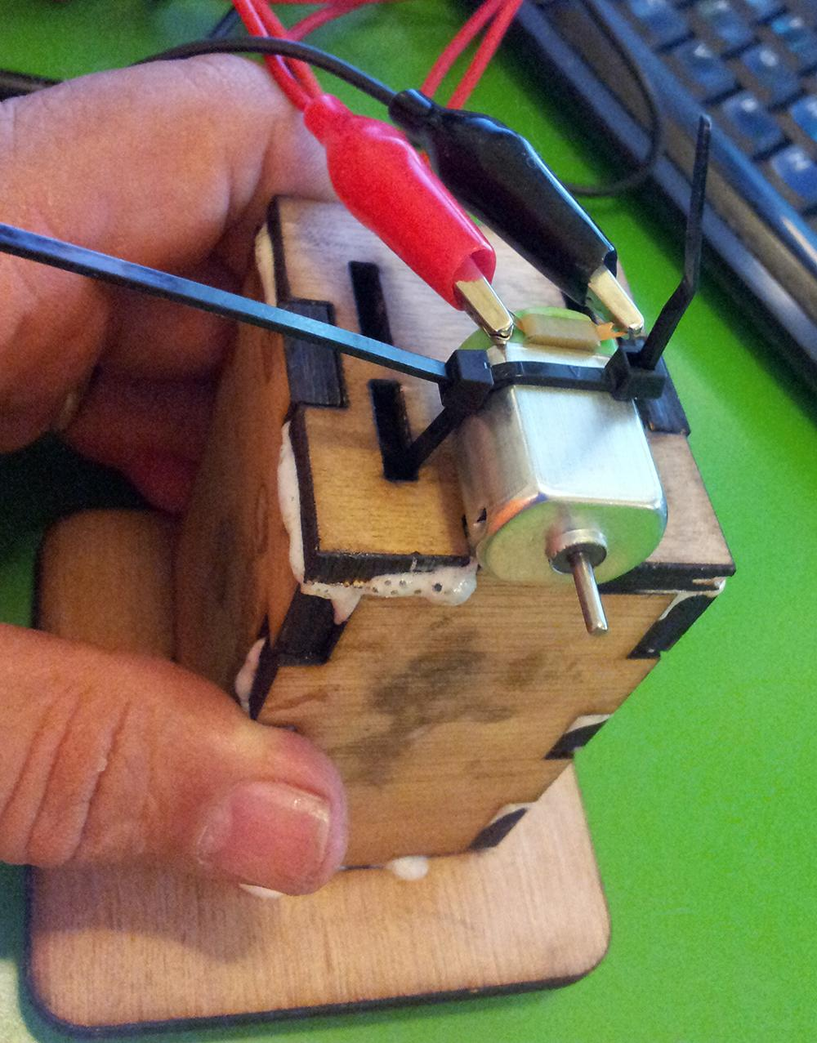
Assemble your tower and by threading zip ties through the slots, strap the generator to your wooden motor assembly.
Notes:
Time to build your very own command center! Assemble your tower and Thread those zip ties through the slots and fasten the generator snugly to your wooden motor assembly. It's like giving your generator a first-class seat on a spaceship!

Slide 16

Attach the wooden wheel to the shaft...
Give
it a FIRM
press if the
wheel doesn't
slide on easily.
It's a tight fit.
Now give it a spin!
Notes:
Time to attach your wooden wheel to the shaft. If it's being a bit stubborn, don't be shy—give it a FIRM press. It's meant to be a tight fit, like a space helmet on an astronaut!

Slide 17


How much difference do you see in the voltage when you spin the spindle with your fingers vs the wheel?
Record your findings.
Notes:
Compare the voltage output when spinning the spindle with your fingers versus using the wheel. What differences do you notice?

Slide 18
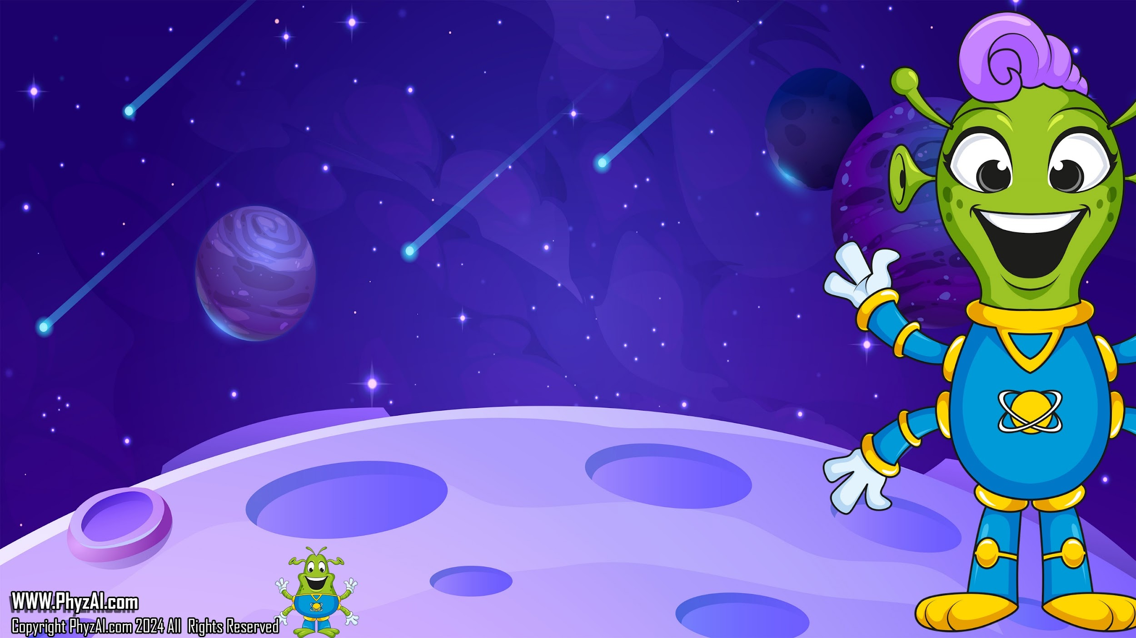
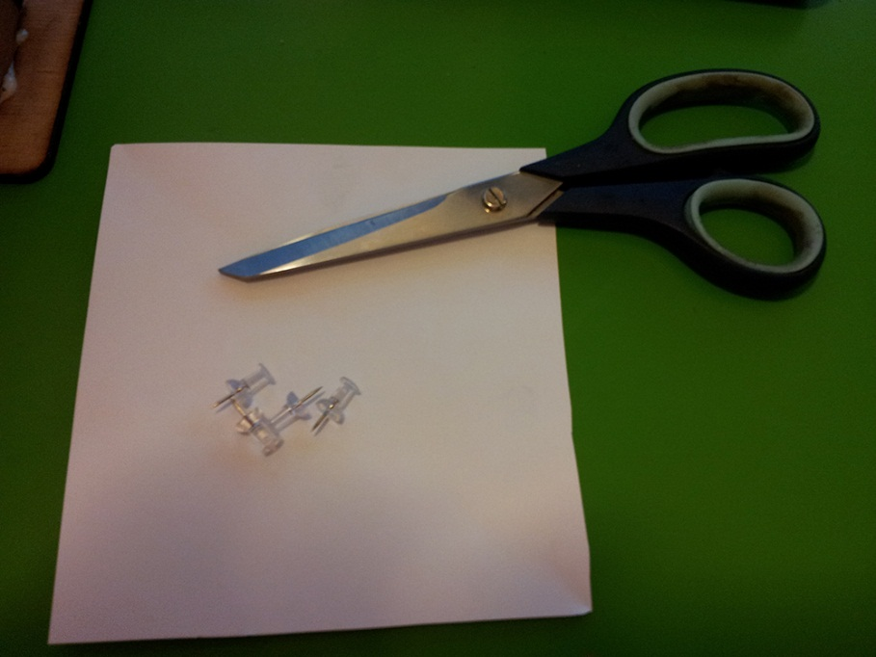
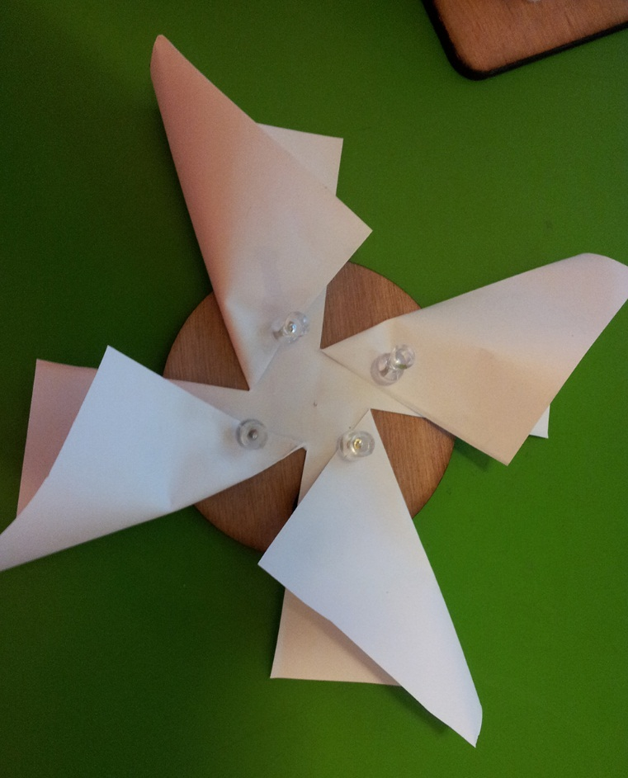
Let's give your generator wheel an upgrade.
For this, you'll need:
1 sheet of paper, 4 thumb tacks & scissors
Cut the paper into 4 squares,
not letting the cuts reach the center of the paper.
Fold each of the squares over
like a propeller and using the thumbtacks, pin this to generator wheel, keeping it centered.
Notes:
Upgrade your generator by creating a paper propeller. Attach it to your wheel to catch the breeze and increase the spinning action.

Slide 19
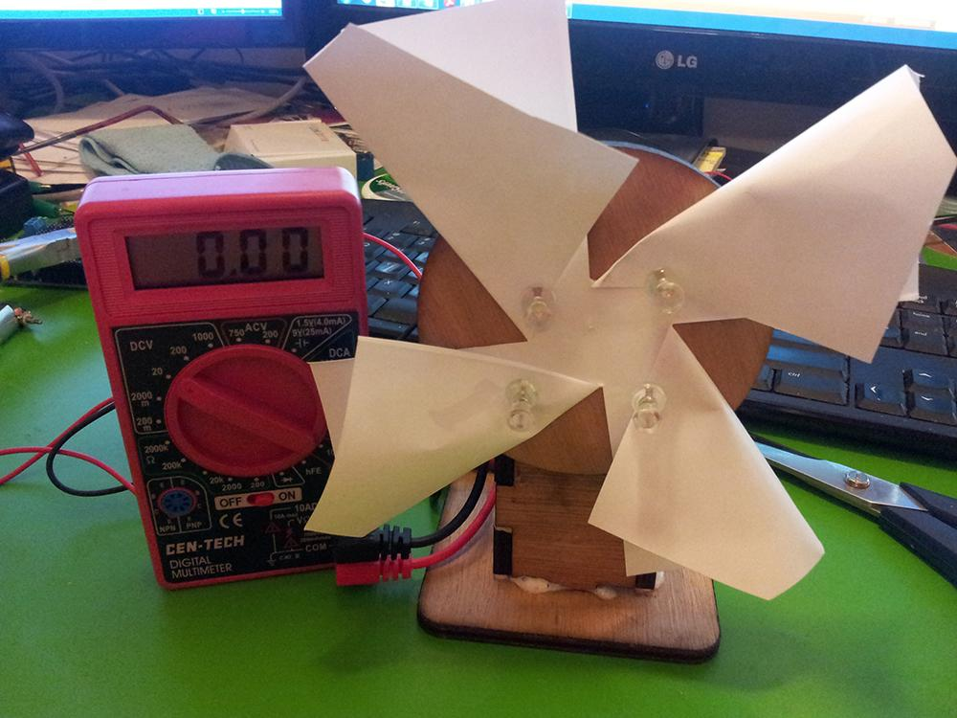
Reattach your generator wheel with its new propeller and see how it spins in the breeze.
Does this look familiar?
Notes:
Reattach your generator wheel with its new propeller and see how it spins in the breeze

Slide 20
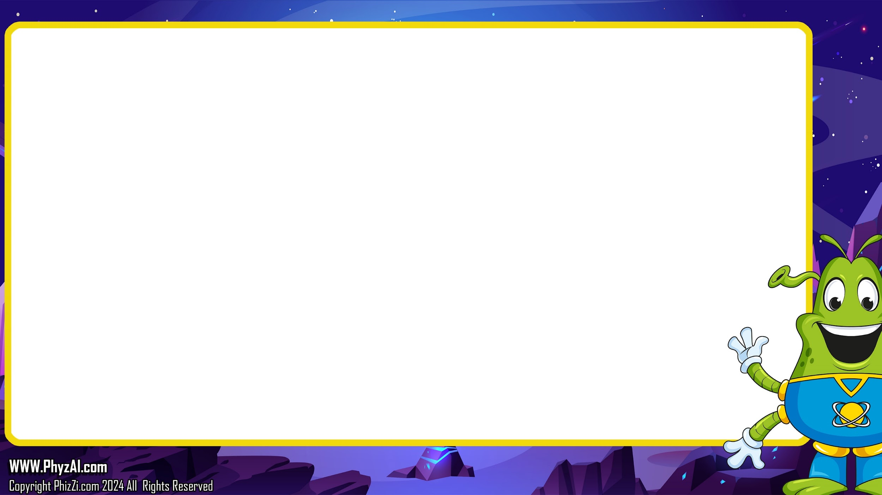
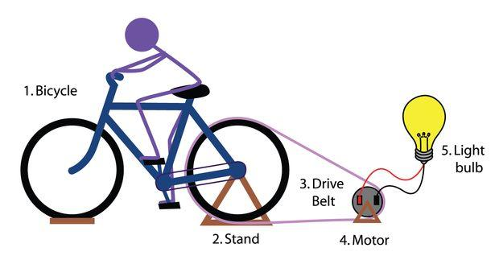
What other ways can you think of to harness mechanical force to turn a generator?
Notes:
Work in teams to brainstorm innovative ways to harness movement to power your generator. Diagram your ideas and prepare to present them! By sharing and challenging one another's ideas, we come to conclusions and solutions that would never happen when working alone.

Slide 21
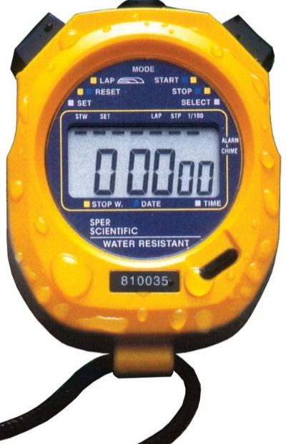
Team work is effective work.
You will now have 20 minutes to work as teams and come up with new ideas for how to harness movement to turn your wheeled generator.
Harness the power of team work to improve your
generator.
Working as a team you will diagram your approach and select one member of your team to give a quick presentation as to why you think your idea will work.
At the end of the 20 minutes we will go around the room and each team will present their findings.
Notes:
‹#›
Work in teams to brainstorm innovative ways to harness movement to power your generator. Diagram your ideas and prepare to present them!
Your teacher will break you into teams. At the end of the 20 minutes we will go around the room and each team will present their findings.

Slide 22
Lets Make a Generator
Notes:
This workshop isn't just about building a generator—it's about sparking curiosity and teamwork. Let's light up our understanding of science as we power not just a motor, but potentially the future of intergalactic travel! And that's a wrap, stellar students! Remember to keep your curiosity turbo-charged and your imagination at warp speed until our next cosmic adventure. So long, and don't forget to wave goodbye to the Blarts! They can't wait to see you next time. Blast off and keep exploring!

